Slide 1



AI Assisted Literature Review: An Entity Extraction Framework for Scholarly Literature
Presented by:
Moobashara Jawed

Slide 2

Named Entity Recognition (NER)
What is Entity Recognition?
Automated identification of key terms (entities) in text into categories like diseases, species or locations.
Recent studies from India have shown that mutations in the BRCA1 gene are strongly associated with breast cancer in Homo sapiens . Researchers at ICMR reported this finding in a paper published earlier this year , highlighting its potential for improving early diagnosis and treatment strategies.
GPE
GENE
DESEASE
SPECIES
GPE
GENE
DATE
DESEASE
ORG
ORG
Species
DATE

Slide 3
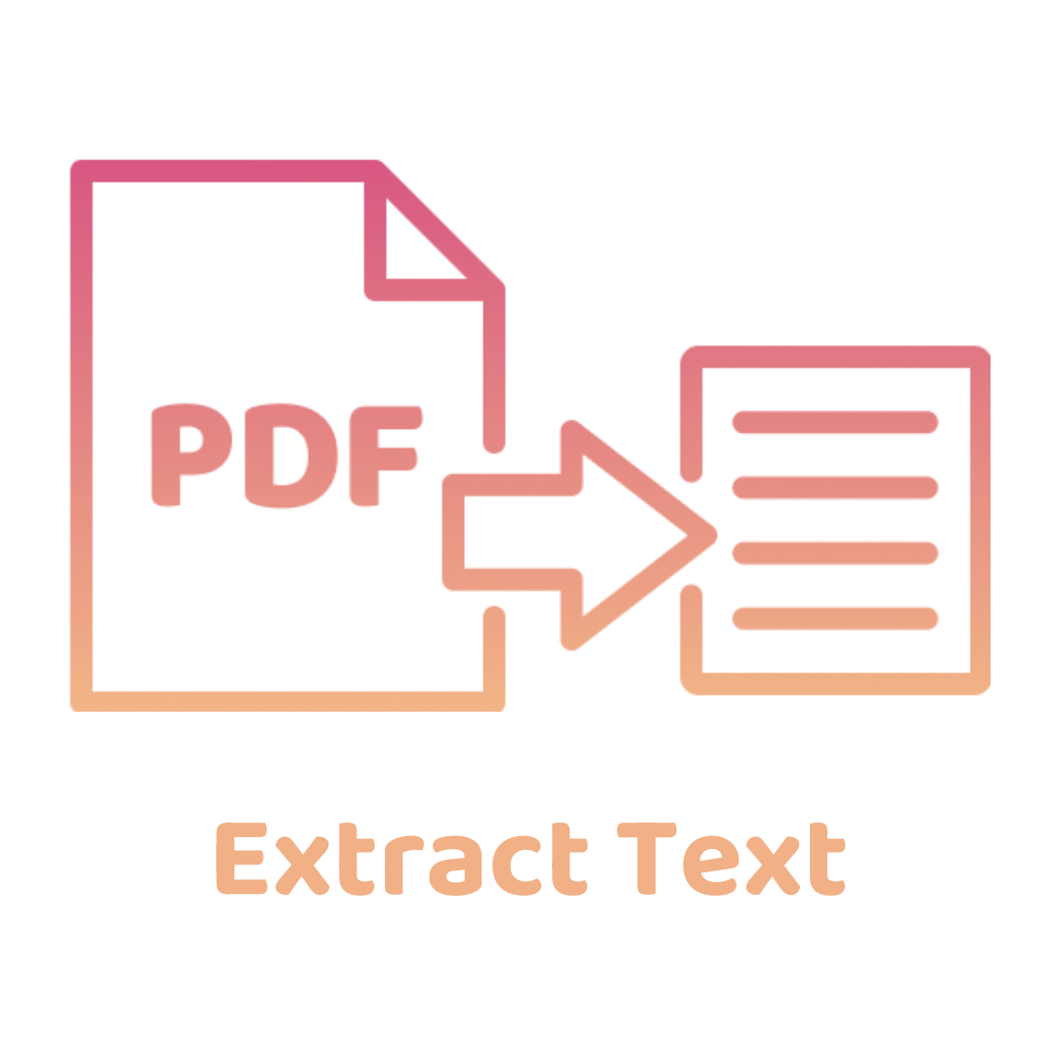

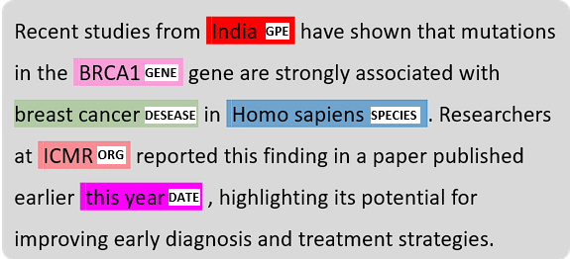

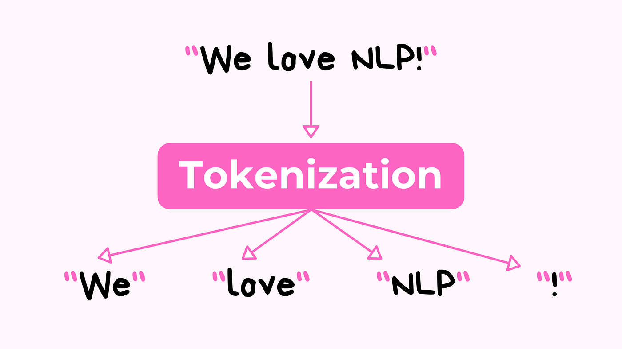
NER Workflow
2
4
Document text extraction via PDF parsers
4. Named Entity Recognition (NER)
1
3
Automated article acquisition via Pygetpapers
3. Text tokenization at sentence granularity

Slide 4
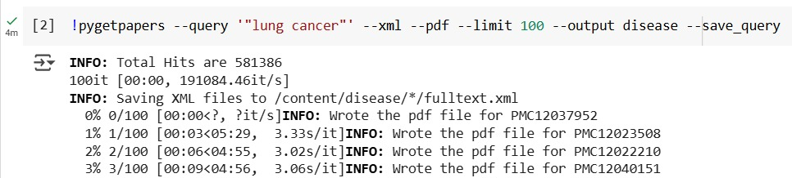
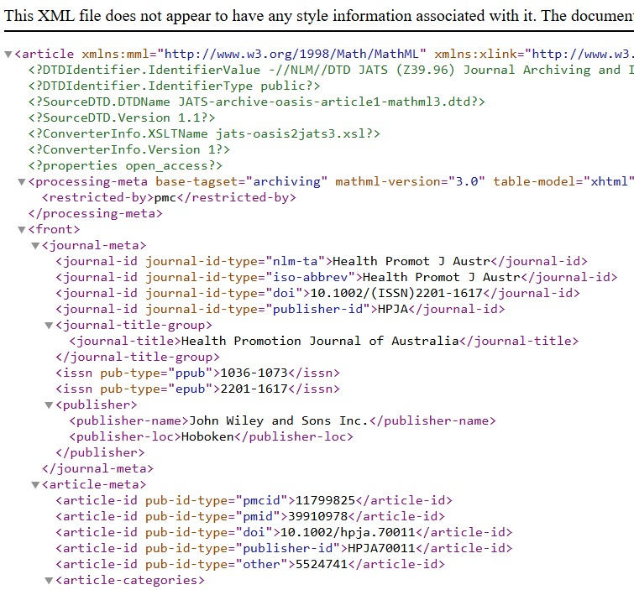

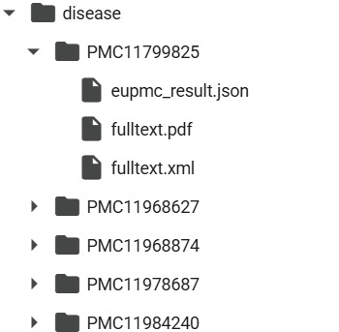
Step 1: Automated article acquisition via Pygetpapers`

Slide 5
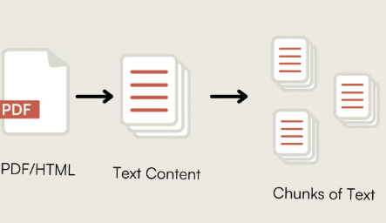
Step 2 & 3: PDF parsing and Text tokenization
2. Parsing is the process of extracting and structuring data from documents, such as PDFs.
3. Tokenization is the process of splitting text into smaller units, such as sentences or words (tokens).
PDF
PDF Parsing Packages: fitz (from PyMuPDF)
Fitz: Extracts raw texts from pdfs
Tokenization: nltk.tokenize.sent_tokenize
Splits text into sentences

Slide 6
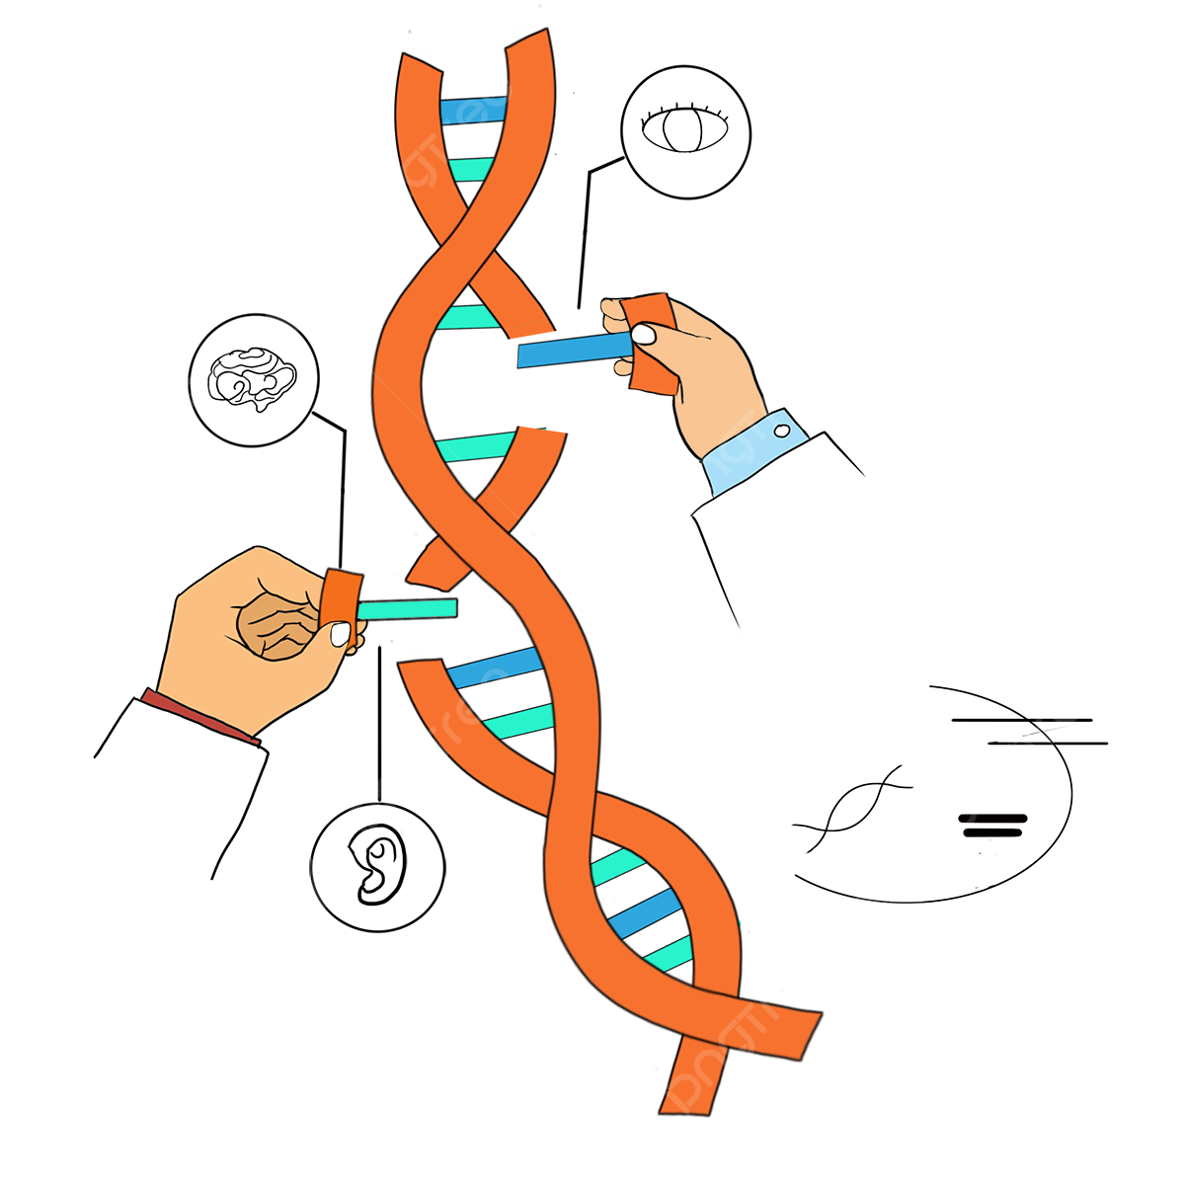








Step 4: Named Entity Recognition (NER)
Gene/Gene products
Phytochemicals
Plant parts
Country name
Scholarly papers
Disease
Species

Slide 7
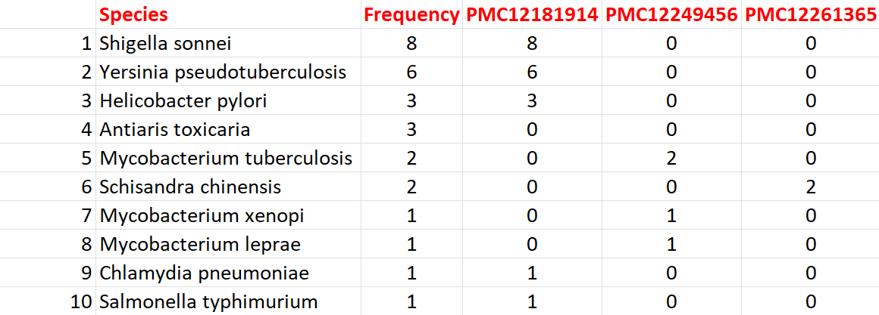
Species Extraction
Frequency table showing the top 10 species across 3 PMCIDs out of the 50 papers
NER Model: scispaCy en_core_sci_md (scientific text)
Validation:
Regex for binomial nomenclature (Genus species)
GBIF API verification (EXACT species matches)

Slide 8
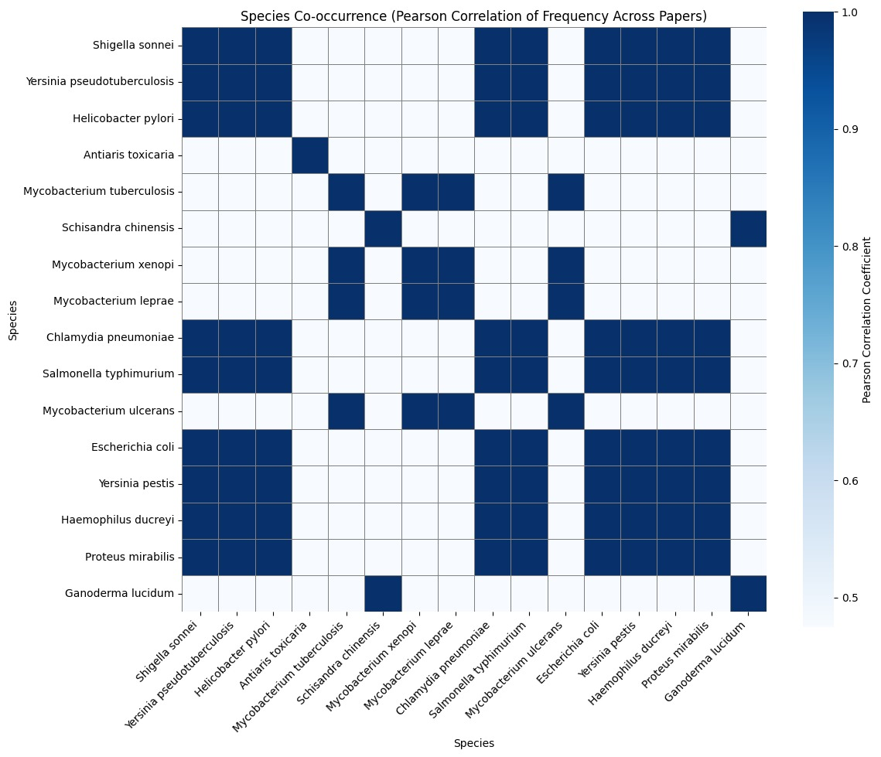
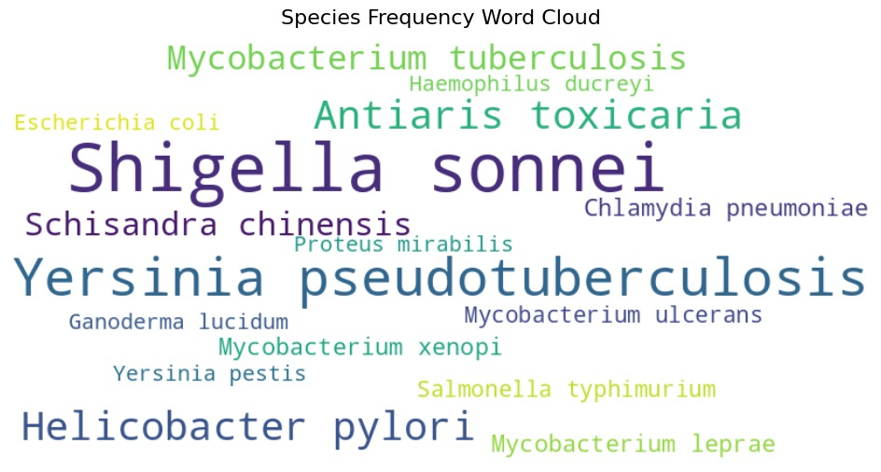
Species Extraction
Word cloud of species obtained from the 50 papers
Co-occurrence plot of species for 50 papers

Slide 9
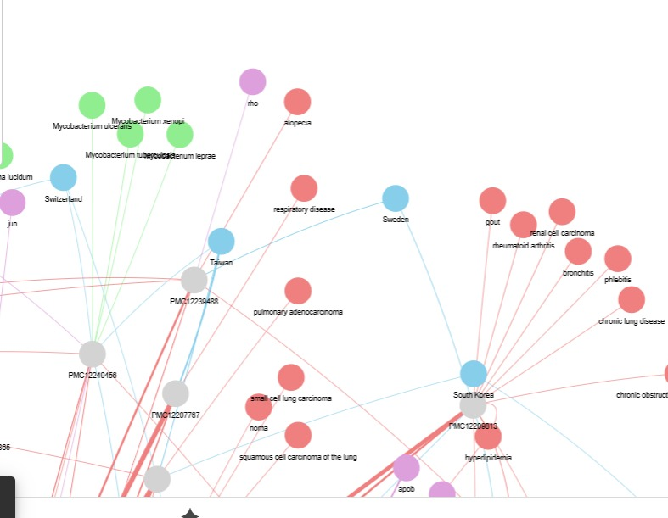
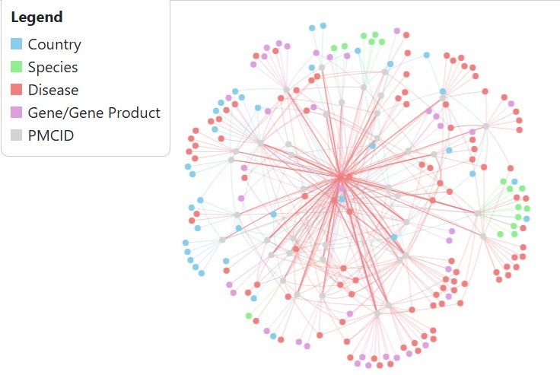
Network of the Extracted Entities
PMC ID denotes the research paper

Slide 10
THANK YOU

